Slide 1

Analysis of Aachen
on opening a new business

Slide 2

Introduction
Problem:
Where to open a new business?
Needed:
Location data
Existing competitors
Segmentation of potential customers
Rental prices

Slide 3

Data Description
Foursquare API -> nearby venues
Service portal of Aachen -> rent index
Zip database -> location of districts
Opendatasoft -> geodata
Data portal of Aachen -> socio-demographic data

Slide 4
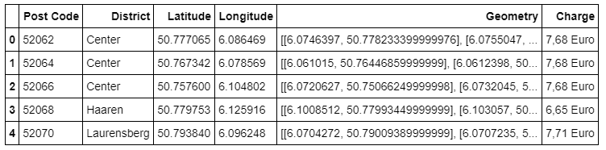
Methodology
Stored on Github and created on IBM Watson Studio
Main data:

Slide 5
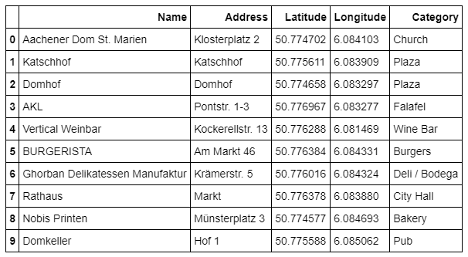
Methodology
Foursquare API:
nearby venues

Slide 6
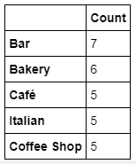
Methodology
Grouping the venues by types:

Slide 7
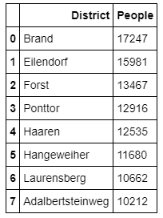
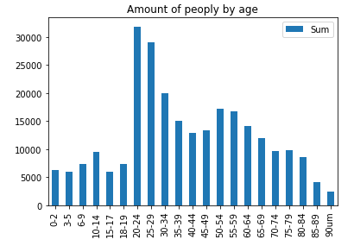
Methodology
Potential customer data:

Slide 8
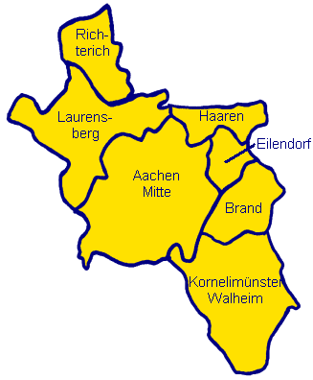
Conclusion
Largest market: bars, bakeries, cafés
People:
mostly between 20-34
Mainly living away from the center
-> opening in these areas
-> due to lower rental prices an incresed number of people

